Slide 1
Cloud Computing
Enjoy the convenience.
Benefits
Cost Savings
Security
Flexibility
Mobility
Insight
Increased Collaboration
Quality Control
Disaster Recovery
Loss Prevention
Automatic Software Updates
Competitive Edge
Sustainability

Slide 2
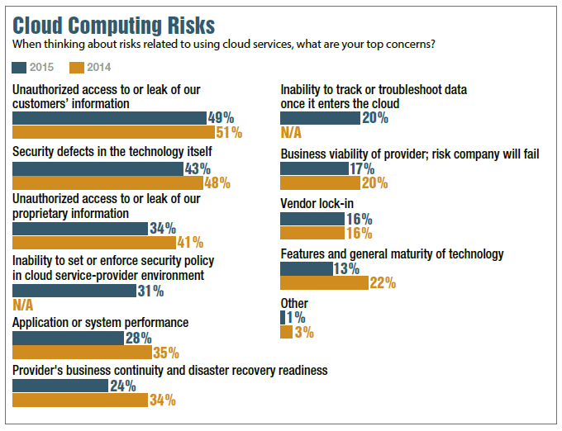
Cloud Computing
Security like never before
Risks
#1. Unauthorized access to customer and business data
#2. Security risks at the vendor
#3. Compliance and legal risks
#4. Risks related to lack of control
Considerations
Security
With cloud computing, you are entrusting the security of your mission sensitive data to a third party. The provider must be able to meet industry regulations and compliance needs. It is also equally important for them to be able to illustrate who has access to your data, and what systems, infrastructures and environments your data touches throughout its life-cycle.
Availability
How does the provider ensure up-time and data availability? The Service Level Agreement (SLA) can offer some insight into the provider’s capabilities. Keep in mind, however, that even SLAs that offer 100% guaranteed up-time may not provide the protection you need, as many are capped at the monthly service fee – an amount far less than the cost to the business if the service becomes unavailable or if data is lost.
Mobility
For many businesses, the adoption of a cloud computing solution is a multi-step process – one that begins with virtualization and colocation, and then transforms into a private and then public cloud solution. It is important to ensure that the provider offers physical colocation along with their cloud offerings. This allows for the seamless communication of data and applications across physical and virtual platforms.

